Slide 1
DEVELOPING A WEB APPLICATION FOR EVENT BASED SERVICE BOOKING SYSTEM
DEPARTMENT OF COMPUTER SCIENCE &IT,
UNIVERSITY OF JAMMU
SUBMITTED BY:
Sangeeta Devi(06MCA21)
Falgun Mahajan(34MCA21)

Slide 2
About The Project
The project work is for fulfilment of the requirements for the award of degree of
Masters In Computer Application (MCA)
Title | Details
Project Name | Event Management
Project Type | Event based service booking system
Submitted By | Sangeeta Devi(06MCA21) Falgun Mahajan(34MCA21)
Supervisor | Prof. Lalit Sen Sharma

Slide 3
About Event Management
Event Management is a comprehensive web-based platform in which:
For customers, we provide a one-stop destination to discover and book, a wide range of services related to events like weddings, college farewells, birthdays, and conference meetings.
On the other side, service providers can efficiently add their services and view customer booking.

Slide 4
Problem Statement
In today's fast-paced world, organizing events such as weddings, college farewells, birthdays, and conference meetings can be a complex task.
It often involves multiple service providers, from venue booking and catering to decoration and entertainment, leading to a fragmented and cumbersome process for event planners and hosts.
The current event management industry lacks a comprehensive and centralized platform that provides all the services related to various types of events, including weddings, college farewells, birthdays, and conference meetings.
Additionally, the absence of a unified platform makes it challenging for customers to find reliable and suitable service providers efficiently

Slide 5
Problem Solution
One-stop event management system that will act as a centralized platform where customers can explore a wide range of services required for events including venue options, catering services, photographers, decorators, entertainment providers, and more.
View the list of all the service providers of a required services.
Choose filters to view the suitable service providers.

Slide 6
Technologies used
Area | Technology
Back-end | Node JS(Express JS)
Front-end | HTML(HBS), CSS, JavaScript, Bootstrap
Database | MongoDB

Slide 7
MongoDB Collections Used
Admin Module
admins
service models
parameter models
service options
Service Provider Module
service providers
caterings
venues
decorations
mehndi artists
Customer Module
customers
booked services

Slide 8
Data Flow Diagrams
Admin Module
Service Provider Module
Customer Module
Admin
Service Provider
Customer
Login
Register or Login
Register or Login
Select Services like Catering, Venues, Photography and many more
Select Services like Catering, Venues, Photography and many more
Dashboard
Add Services, Parameters,
Options
View Service providers & Customer s
Select parameters for Services
Book Services and Make Payment

Slide 9
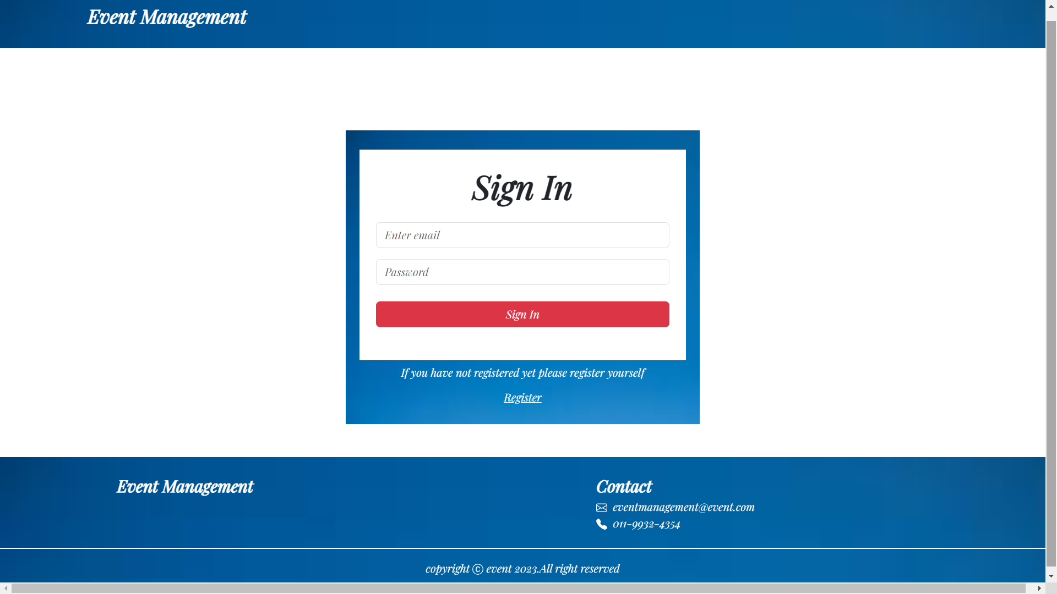
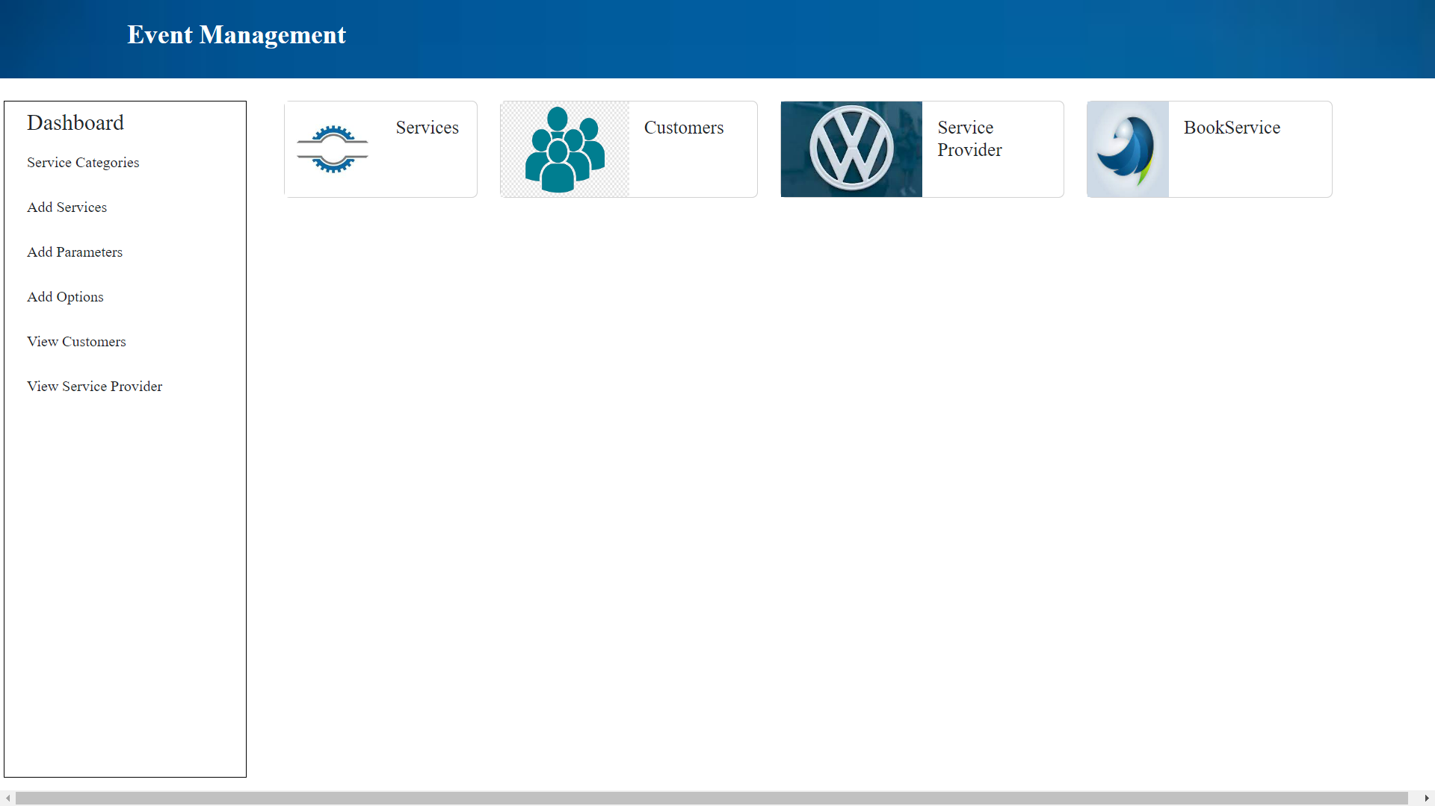
Admin Module
Login Page
Dashboard

Slide 10
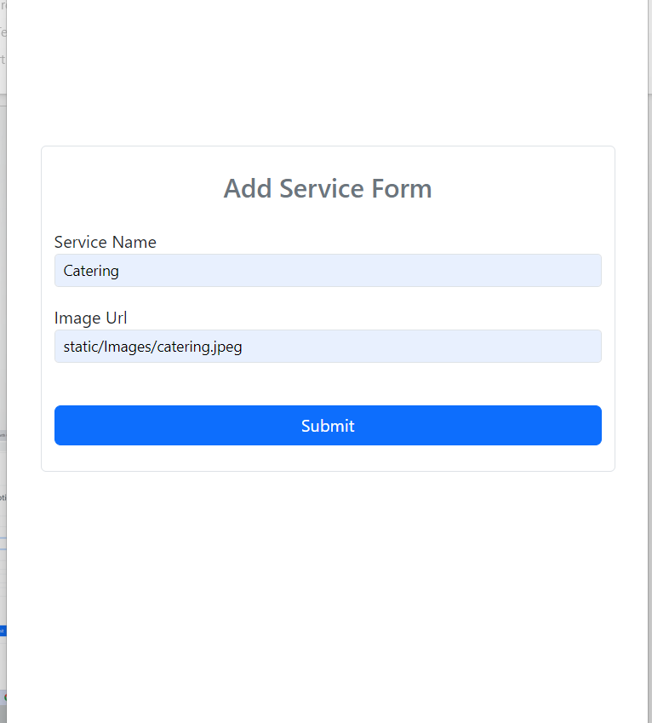
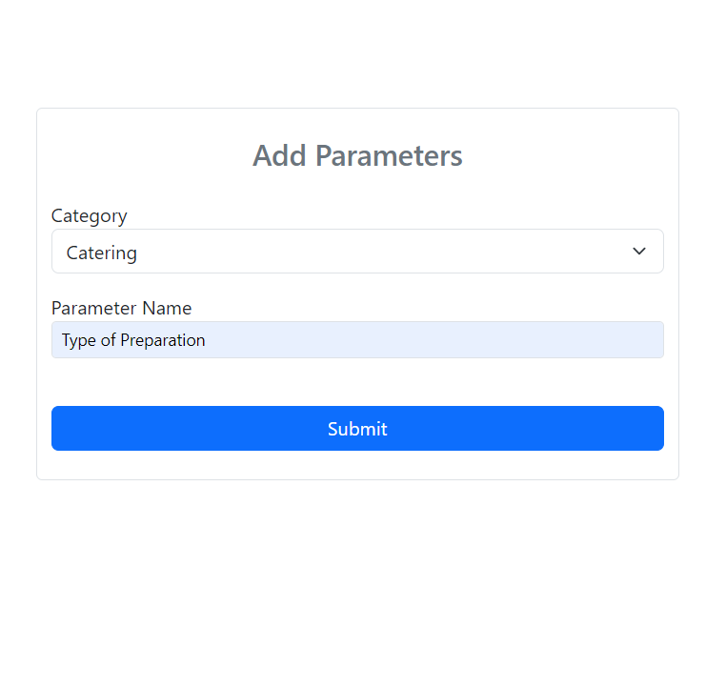
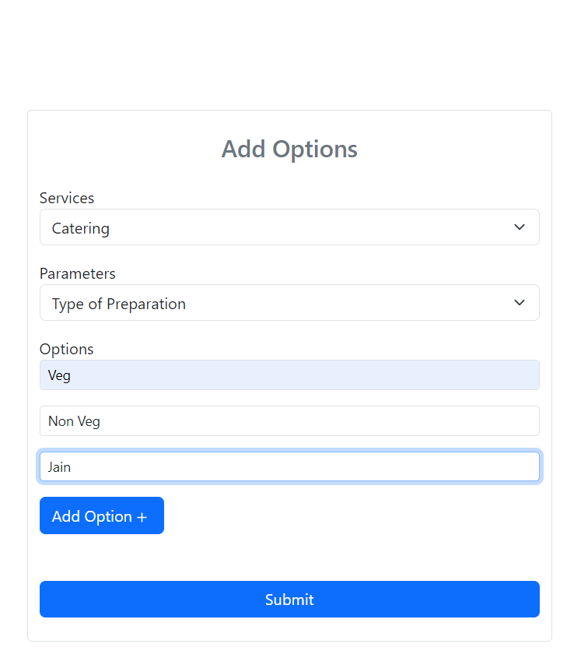

Slide 11

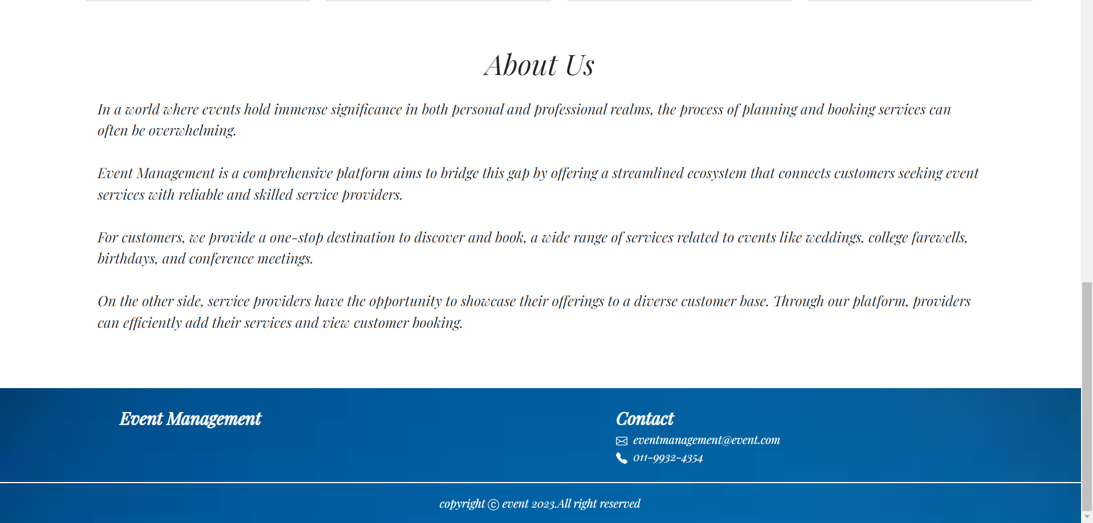
Landing Page

Slide 12
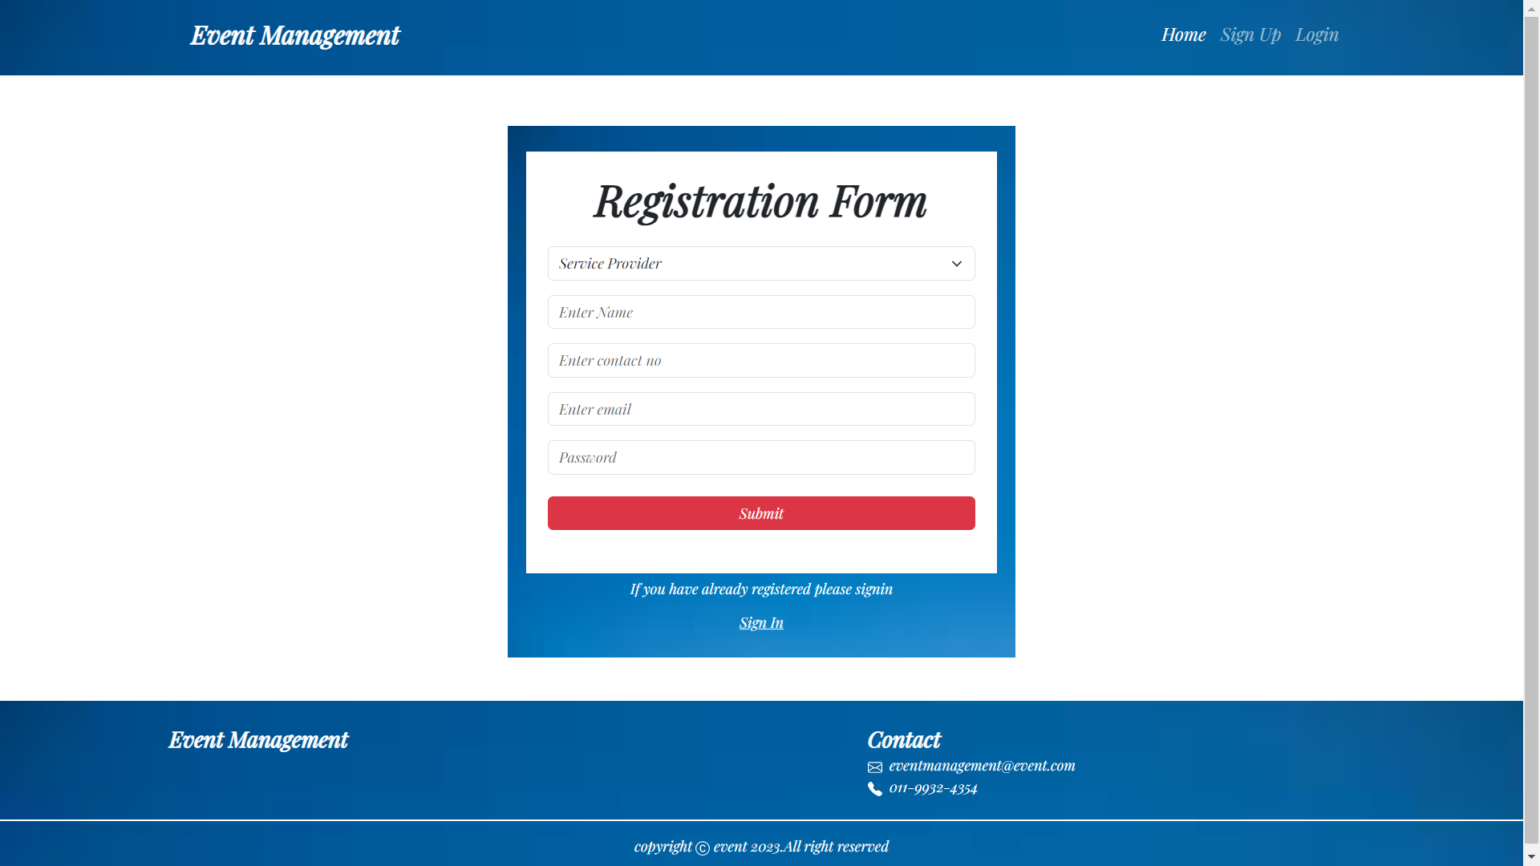

Registration Page

Slide 13
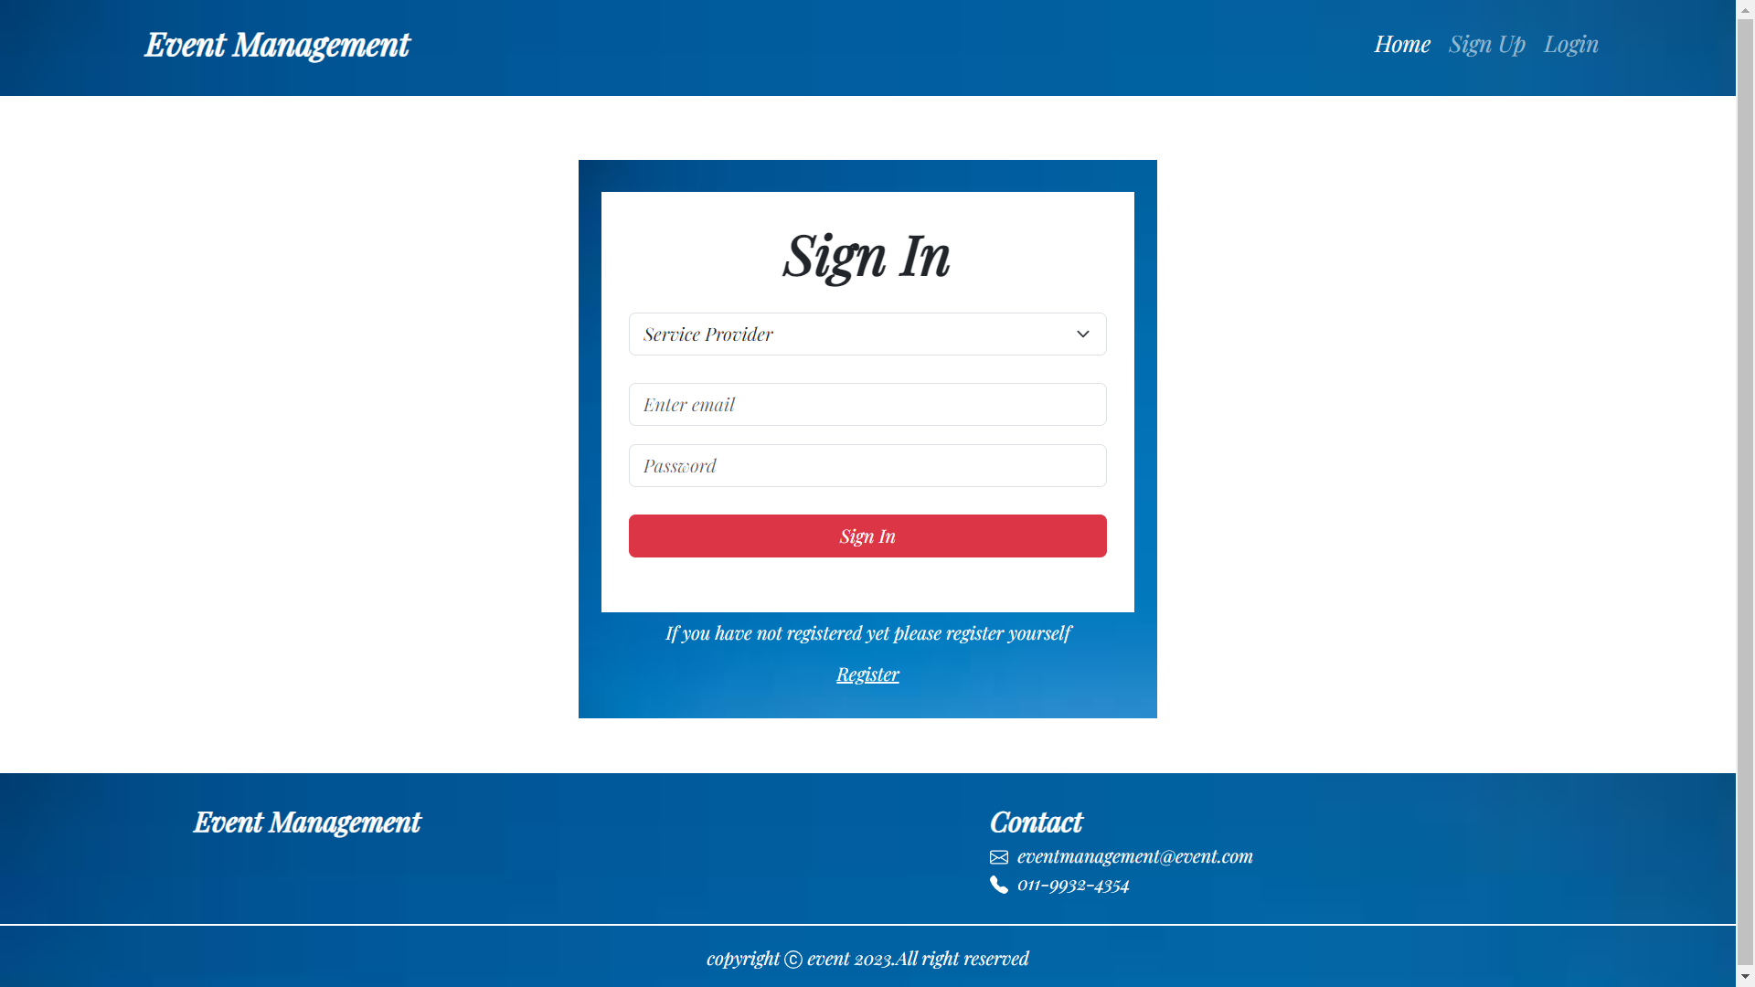

Login Page

Slide 14
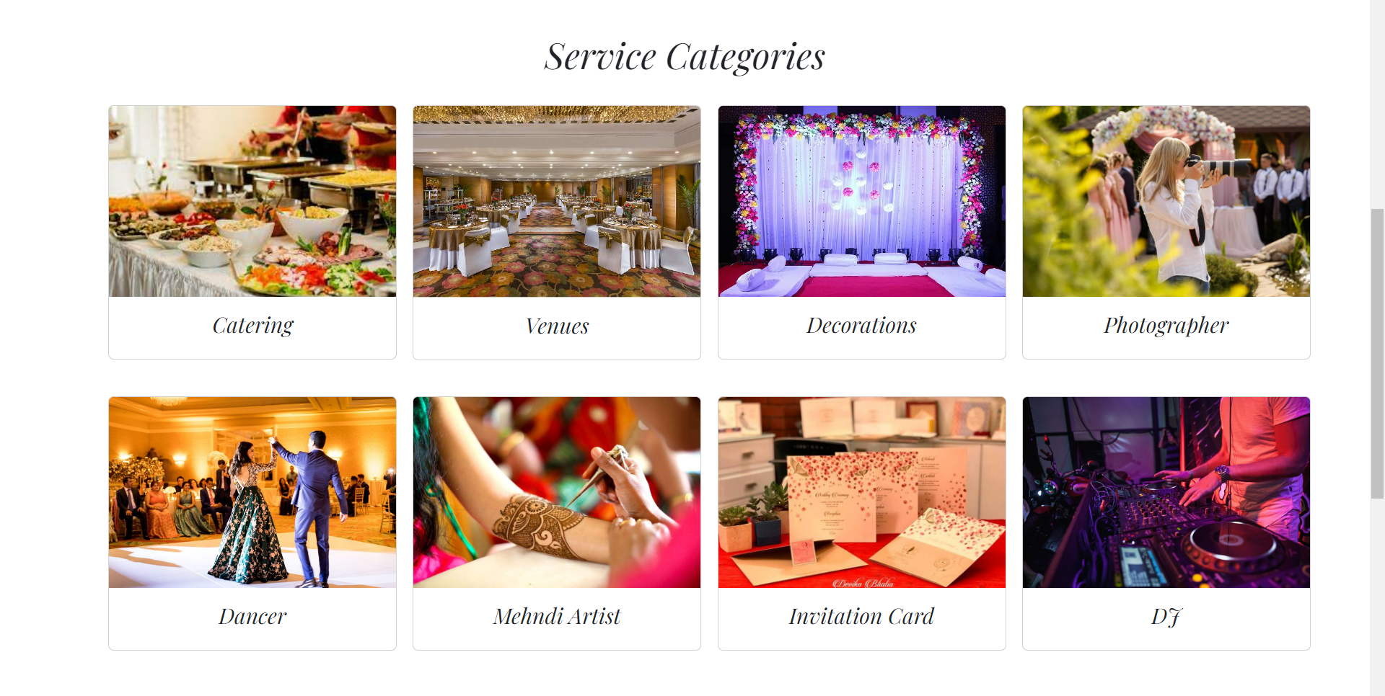
Services Offered

Slide 15
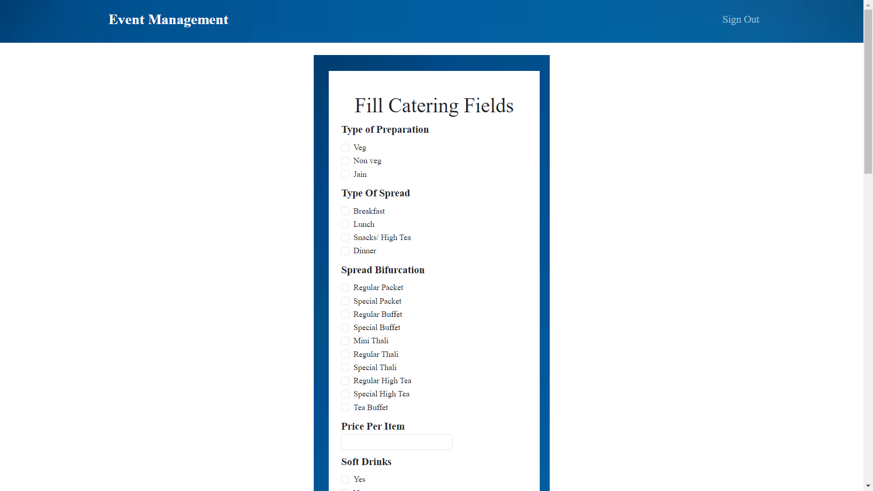
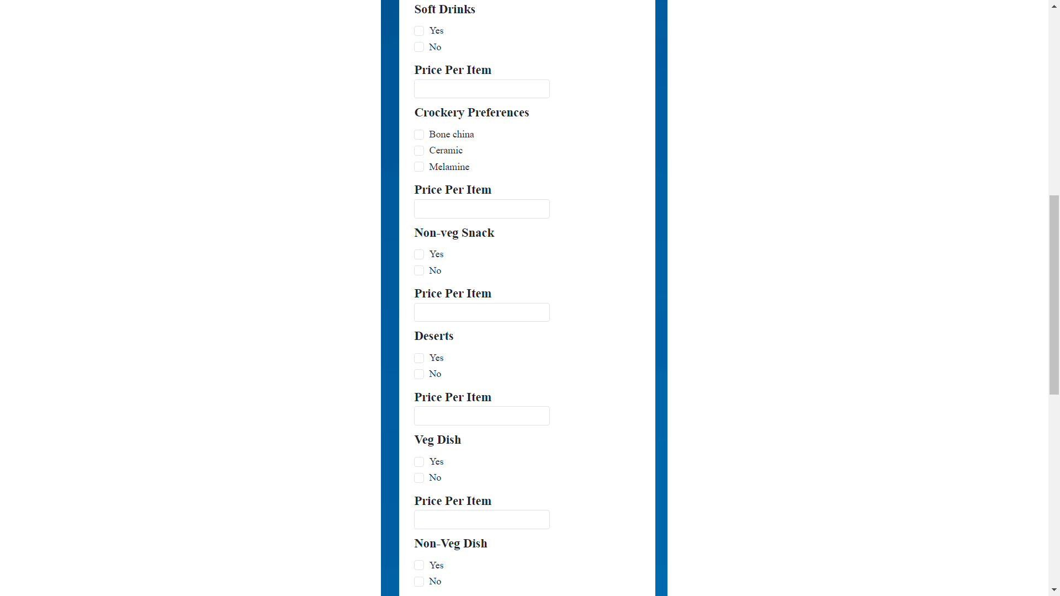
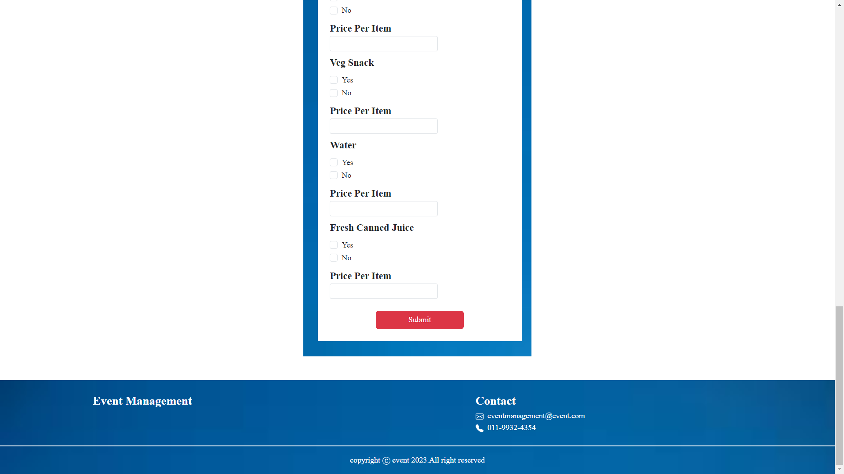
For Service Provider

Slide 16
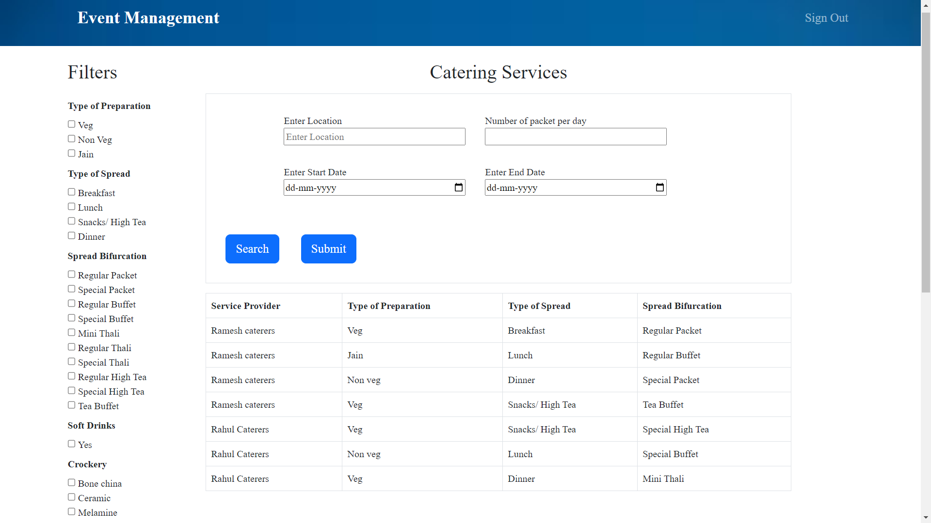
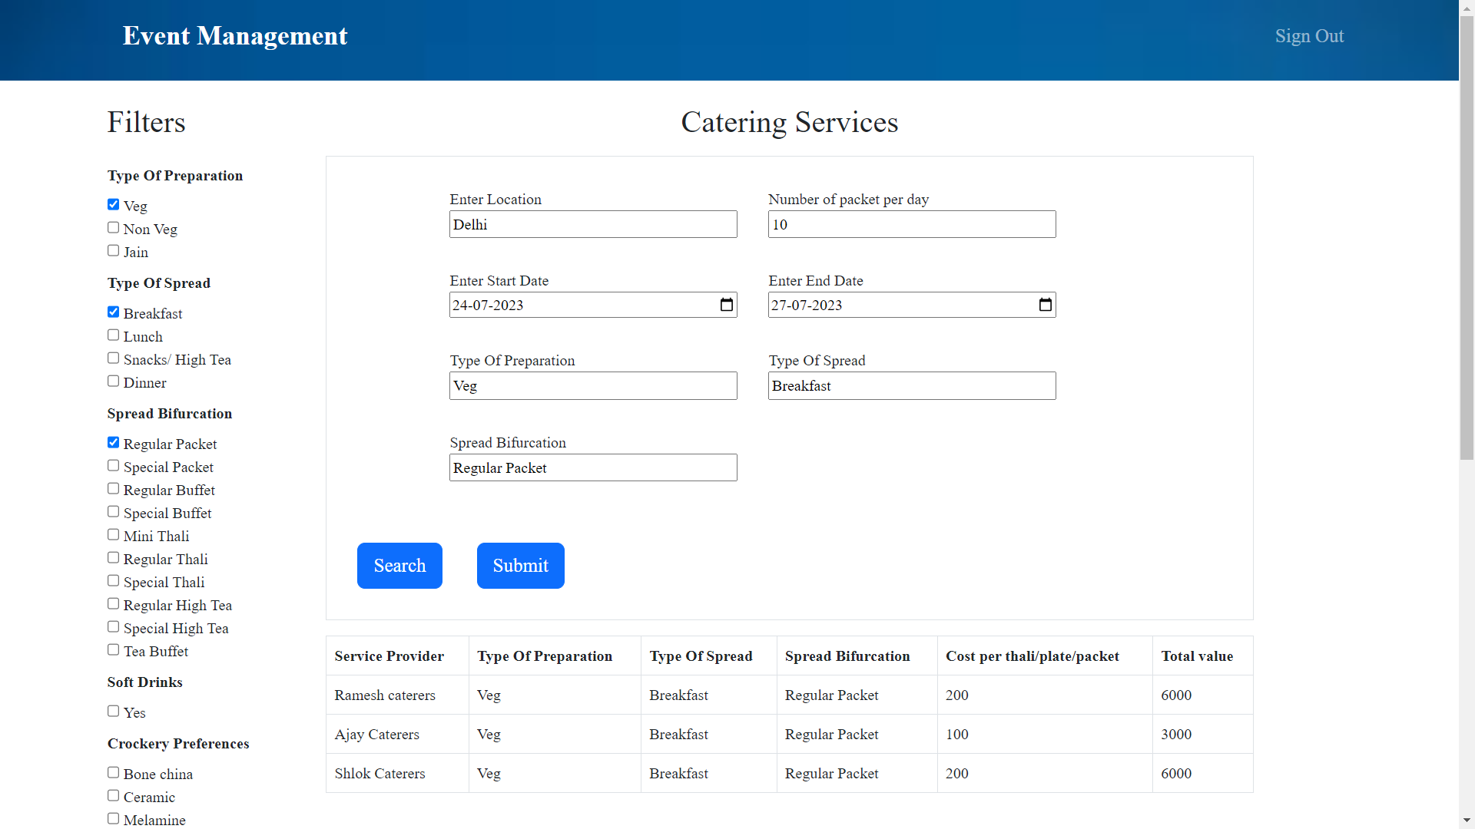
For Customer

Slide 17
Yet To Add
Design frontend forms for other services.
Payment Method.

Slide 18
Thank You

